Slide 1

Youtube Dataset Analysis
KARMUKILAN D K

Slide 2
TABLE OF CONTENTS
01
03
02
04
ABOUT DATASET
INSIGHTS
PREPROCESSING
CONCLUSION

Slide 3
ABOUT DATASET
YouTube is an American online video sharing platform owned by Google.
Accessible worldwide, YouTube launched on February 14, 2005, by
Steve Chen, Chad Hurley, and Jawed Karim, three former employees of PayPal.
Headquartered in San Bruno, California, United States, it is the second most visited website in the world, after Google Search.
The dataset covers various metrics related to YouTube channels, including subscriber counts, video views, channel types, country-wise data, unemployment rates, and earnings by category.

Slide 4

INSIGHTS

Slide 5
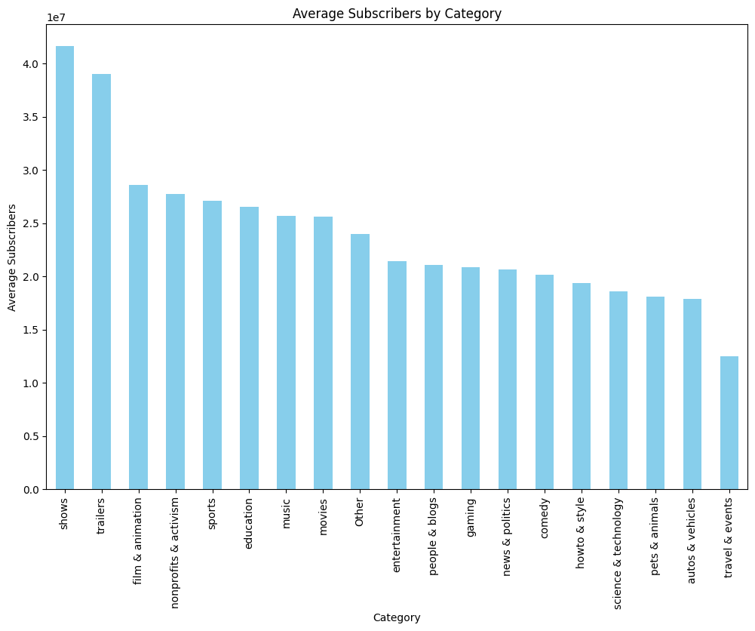
Average Subscribers by Category

Slide 6
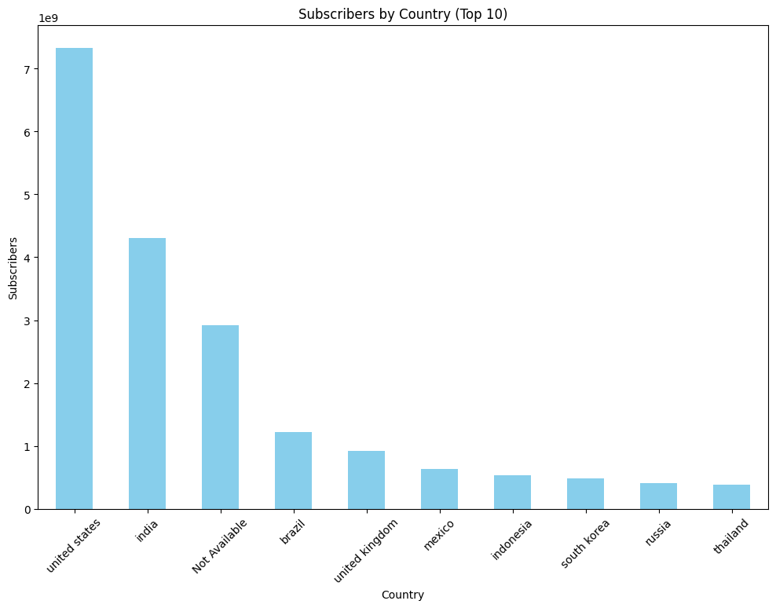
Subscribers by Country

Slide 7
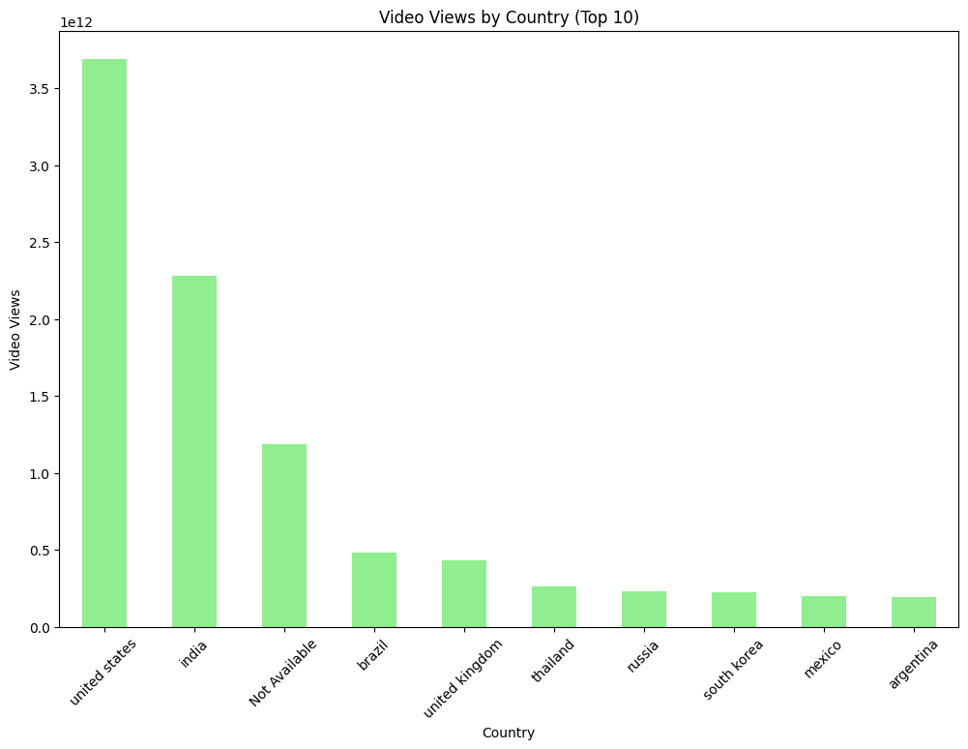
Video views by Country

Slide 8
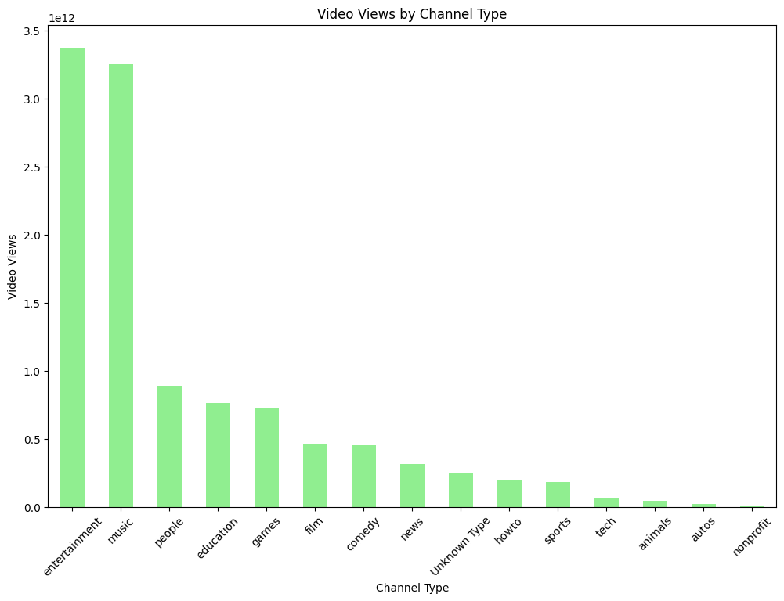
Video views by Channel type

Slide 9
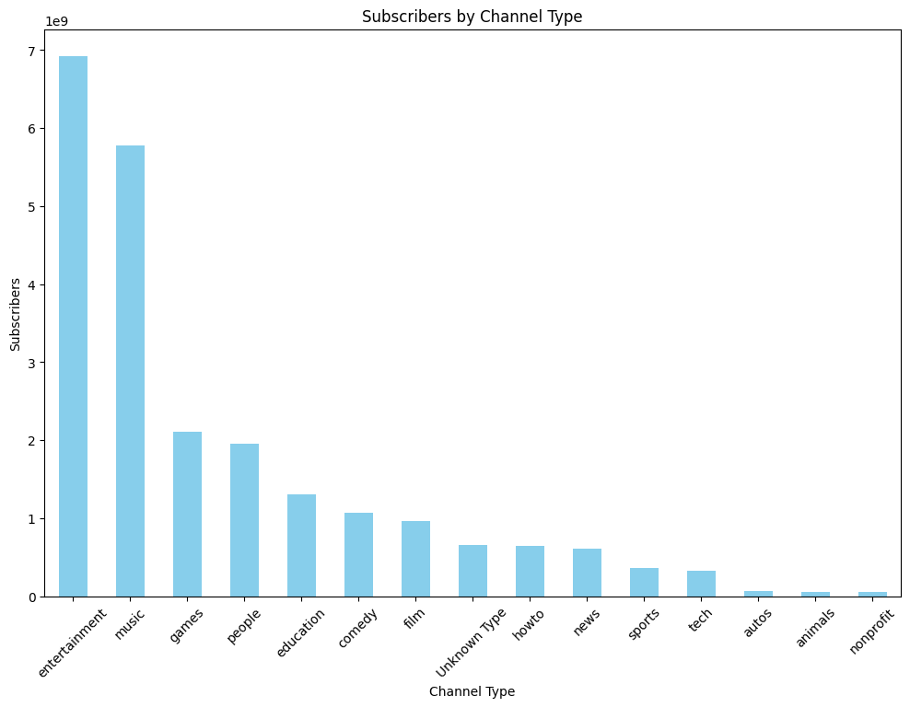
Subscribers by Channel Type

Slide 10
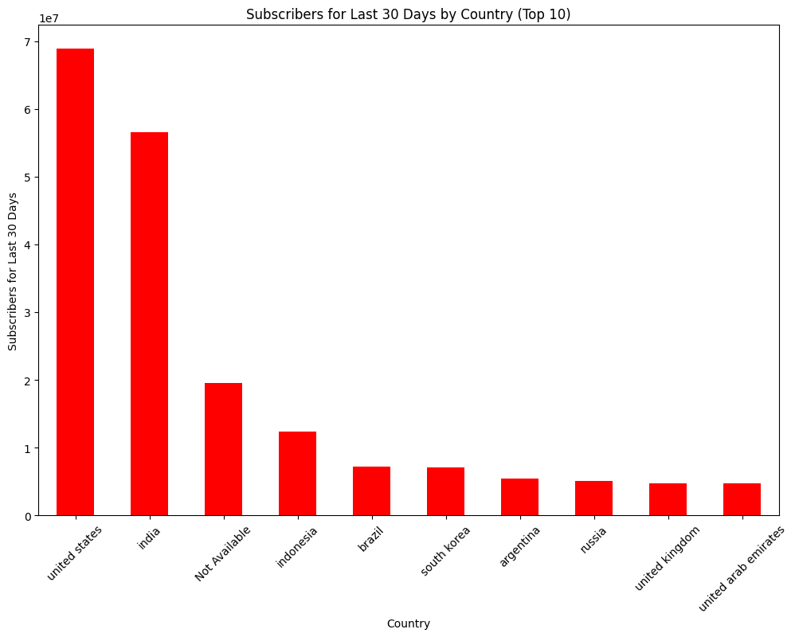
Subscribers by Country (Last 30 days)

Slide 11
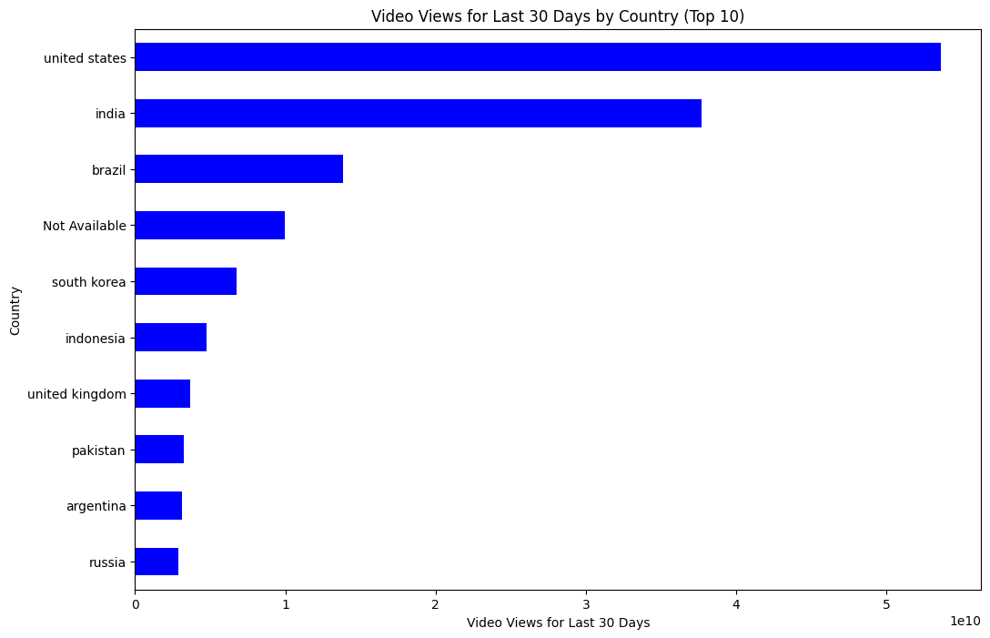
Video Views Last 30 days

Slide 12
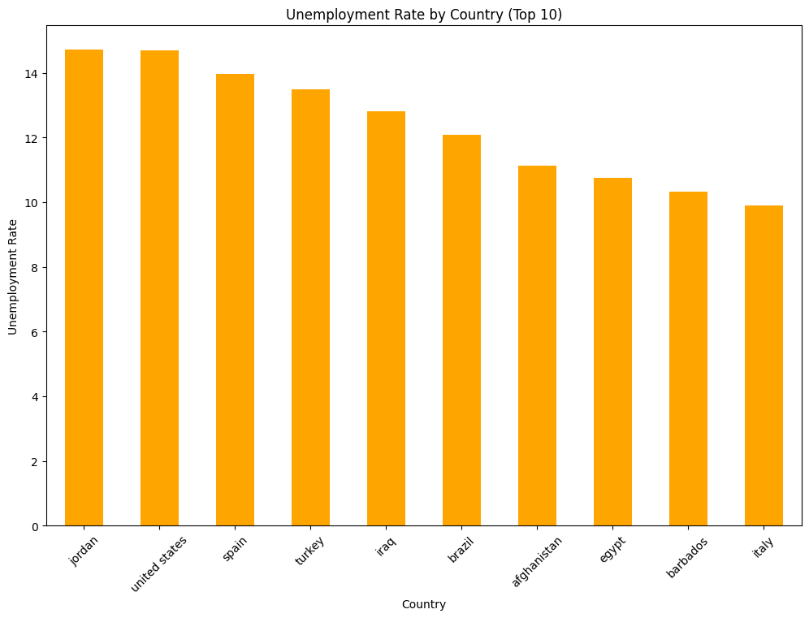
Unemployment rate

Slide 13
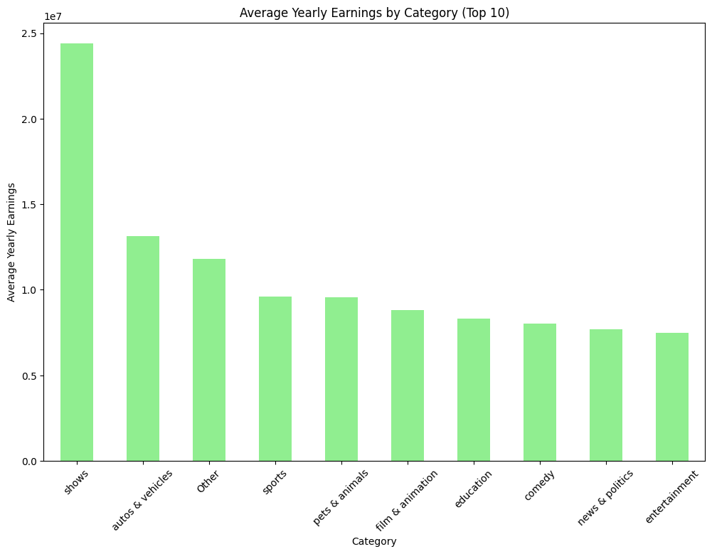
Earnings by Category

Slide 14


Slide 15
Summary
Shows and Entertainment categories are highly effective in attracting subscribers and earnings.
The United States and India are critical markets for YouTube in terms of subscribers and video views.
Entertainment and Music channels consistently draw high viewership.
The trend of subscriber and view growth remains strong in the US and India.
Unemployment rates can influence YouTube content consumption and subscription trends.

Slide 16
Recommendations
Content Strategy:
Focus on creating Shows, Entertainment, and Music content to attract more subscribers and views.
Market Focus:
Target marketing efforts primarily on the United States and India to maximize reach and engagement.
Engagement Strategy:
Develop strategies to retain and engage viewers, especially in regions with high unemployment.
Earnings Optimization:
Invest in high-quality production for lucrative categories like Shows and Autos & Vehicles.
Trend Monitoring:
Continuously monitor subscriber and view trends to adapt content and marketing strategies accordingly.

Slide 17
THANK YOU!
KARMUKILAN D K
Please keep this slide for attribution

